Slide 1
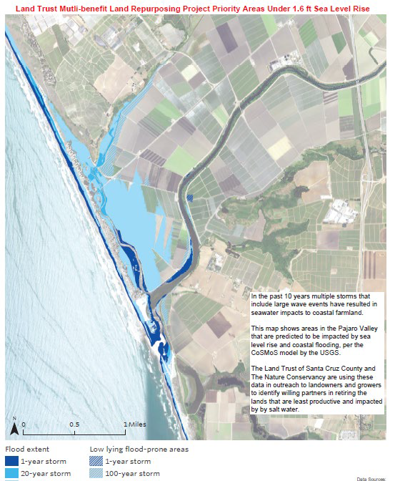
Pajaro Valley’s Multi-Benefit Land Repurposing Program
Pajaro Valley Water Management Agency
Pajaro Regional Flood Management Agency
Resource Conservation District of Santa Cruz County
University of California, Santa Cruz
Land Trust of Santa Cruz County & The Nature Conservancy
Watsonville Wetlands Watch
This proposal will support the development of a long-term land repurposing plan to identify and prioritize land repurposing opportunities and outline strategies for implementing multi-benefit projects to sustain water resources and support agricultural viability in the Pajaro Valley. The grant will prioritize implementation of five pre-identified projects, including repurposing 136 acres of marginal agricultural lands using lake water as an alternative to groundwater as well as the development, permitting and design activities for two Recharge Net Metering-managed aquifer recharge project sites and implementation of at least one of the sites to infiltrate at least 100 AFY.
Additional targeted implementation projects include the repurposing of at least 40 acres of frequently flooded or saturated farmland, the acquisition of at least 20 acres of low productivity agricultural land at the confluence of the Salsipuedes Creek and Pajaro River, and construction of a new recharge basin. The proposal reflects strong partnerships between water, environmental and conservation interests, local government, academia, and tribes.

Slide 2
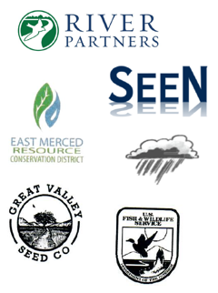
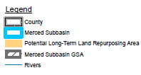
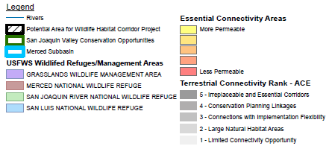
MSGSA Multi-Benefit Land Repurposing Program
Merced Subbasin Groundwater Sustainability Agency
California
Department of Conservation
River Partners
SocioEnvironmental and Education Network
East Merced Resource Conservation District
Sandy Mush Mutual Water Company
Great Valley Seed
La Paloma Mutual Water Company
Merced National Wildlife Refuge
This project will support coordinated efforts to build local capacity to repurpose agricultural land and lower groundwater use across the Merced Subbasin. It will address both overall groundwater overdraft in the Merced Subbasin Groundwater Sustainability Agency jurisdictional area as well as specific “hot spots” where groundwater sustainability indicators are severe. It will do so through a variety of repurposing mechanisms using models developed with a diverse set of local partners to maximize benefits and reduce adverse effects.
The program will focus on developing long-term land repurposing projects and establishing a wildlife habitat corridor between the Sierra Nevada Mountains and the Merced National Wildlife Refuge. Potential strategies include conversion to regenerative agriculture, habitat restoration, developing renewable energy, and creation of groundwater recharge areas. Incentives to facilitate repurposing may include payments to farmers to repurpose their land, conservation easements, and land purchasing.

Slide 3
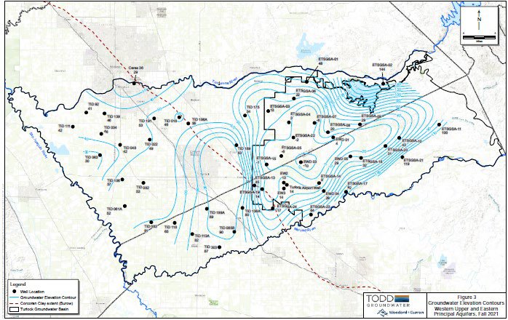
Turlock Subbasin Multi-benefit Land Repurposing Program
East Turlock Subbasin Groundwater Sustainability Agency
West Turlock Subbasin Groundwater Sustainability Agency (GSA)
Merced and Stanislaus Counties
Turlock Irrigation District
Eastside Water District
Sand Creek Flood Control District
The proposal will focus on leveraging prior and ongoing work in the area to further identify land repurposing plan objectives through existing tools, outreach, and collaboration, updating and refining the Recharge Assessment Tool (GRAT) to better simulate recharge and repurposing strategies, identifying opportunities for repurposing, re-cropping, and cover cropping, and identifying opportunities for solar power projects and agrovoltaics. Initial repurposing strategies identified through this proposal include orchard swale rewilding, floodplain reconnection, and recharge storage basins, with a focus on projects around areas where domestic wells are going dry. The GSA would provide incentive payments for lands enrolled in the program that accept conservation easements or term contracts for land stewardship actions for periods of at least 10 years. Only irrigated lands would be eligible for enrollment. While the project area includes the West Turlock Subbasin and GSA, the implementation of land repurposing strategies will primarily focus on the East Turlock subbasin.
Images courtesy of East Turlock GSA

Slide 4
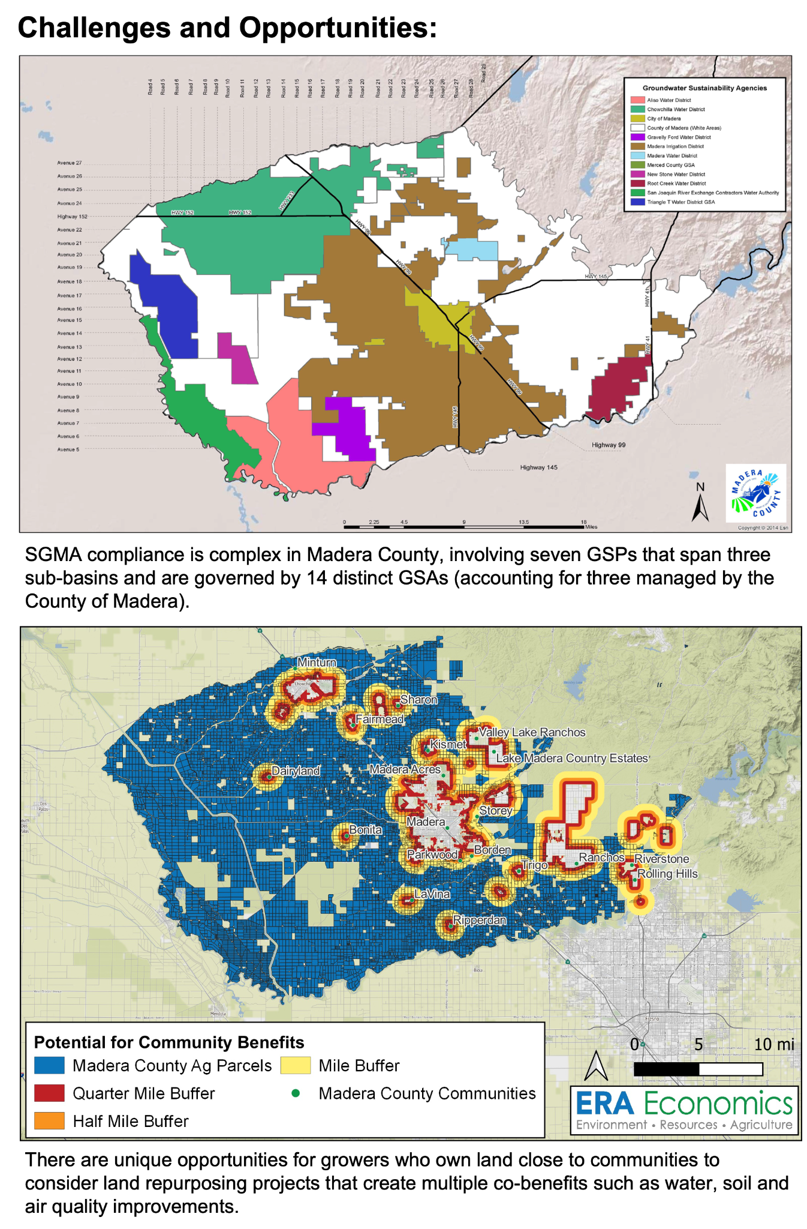
SGMA Agricultural Land Repurposing Program
County of Madera
Madera County
Madera/Chowchilla Resource Conservation District
Madera County Farm Bureau
Madera Ag Water Association
California Farmland Trust
MLRP Madera grant funds will be used to reward and incentivize landowners who are interested in voluntarily repurposing agricultural lands to new uses that save water and create benefits for disadvantaged communities and ecosystems.
Project partners are focused on a collaborative approach to engage landowners and residents in the MLRP plan design and process. The program is also striving to make the plan flexible so that it can provide a blueprint for future land repurposing efforts in Madera County and beyond. Key activities include:
Illustrating the business case for various land repurposing strategies
Using workshops and surveys to generate input and ideas for various project types
Building awareness and interest around specific project types and actions that offer multiple benefits to landowners, residents and ecosystems
Connecting MLRP awards to other funding opportunities (to the greatest extent possible).

