Slide 1
Westside Subbasin Multi-Benefit Land Repurposing Program
Westlands Water District Groundwater Sustainability Agency
LEAP
Civic Well
Sequoia Riverlands Trust
Linguistica
Vista Consulting
The proposal will expand land repurposing efforts in the Westside Subbasin through an inclusive community engagement process that considers multiple beneficial uses, engages residents and landowners, reduces groundwater use, and supports wildlife habitat to help the Subbasin achieve its sustainability goal as outlined in the Westside GSP. Plan implementation will include a focus on creation of multi-benefit recharge areas, transitioning irrigated land to dryland farming or non-irrigated rangeland, facilitating renewable energy projects that have an overall net greenhouse gas reduction benefit, creating or restoring wildlife habitat, and/or land and easement acquisitions to facilitate the repurposing of land uses. Outreach, education, and training funds will be used to support community engagement efforts as well as a pilot program to transition farmworkers to other high-skilled jobs, specifically recycled water retrofits and installs to support the City of Huron’s new recycled water ordinance.
Images courtesy of Westlands Water District GSA

Slide 2
Lower Salinas Valley Multi-Benefit Land Repurposing Strategy and Phase 1 Project Development
California Marine Sanctuary Foundation
Salinas Valley Basin Groundwater Sustainability Agency
Central Coast Wetlands Group
City of Salinas
Ag Land Trust
Elkhorn Slough Foundation
Amah Mutsun Land Trust
Resource Conservation District of Monterey County
Monterey County Water Resources Agency
Castroville Community Services District
This grant will fund work by a broad coalition of partners from multiple sectors, including disadvantaged communities and tribes, to strategically and voluntarily repurpose the Lower Salinas Valley's least viable agricultural lands to produce multiple water resource benefits. Partners collaborate on planning, developing and implementing strategies to fallow and repurpose agricultural lands for floodplain and habitat benefits. The majority of the funding will be used to acquire easements and fee title to land identified for floodplain setbacks and recharge areas and will facilitate progress toward completing project designs.

Slide 3
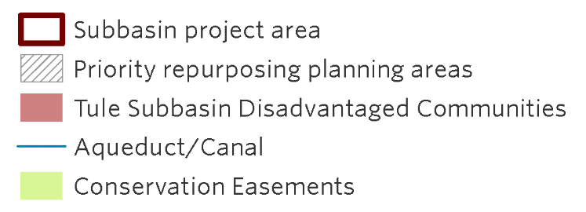
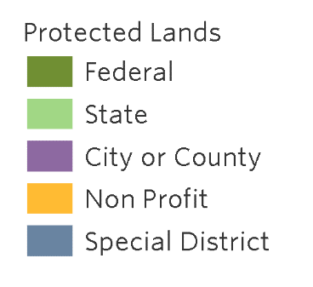
Tule Subbasin Multi-benefit Land Repurposing Program
Pixley Irrigation District Groundwater Sustainability Agency
Eastern Tule Groundwater Sustainability Agency
Tri-County Water Authority Groundwater Sustainability Agency
The Nature Conservancy
Audubon California
The Tule Basin Land & Water Conservation Trust
Sequoia Riverlands Trust
Self-Help Enterprises
SocioEnvironmental and Education Network
UC Merced
The Tulare Basin Watershed Partnership Network
This proposal aims to facilitate strategic land retirement, restore habitat, and protect and enhance water resources throughout the critically overdrafted Tule Subbasin to meet regional economic, environmental, and social needs. The proposal includes planning and implementation within the three priority subregions most in need of land repurposing, as well as a subbasin-wide plan to apply lessons learned from land repurposing in the three priority areas across the subbasin.
The proposal includes funding for pilot projects that will be representative of future regional work, such as upland restoration of fallowed lands, as well as additional funding to implement yet to be identified projects. This proposal includes partnerships with a diverse group of stakeholders including water agencies, disadvantaged communities, and environmental groups, that support the coordinated execution of the project.

Slide 4
MLRP Grant for the Kaweah Subbasin
Kaweah Delta Water Conservation District
East Kaweah Groundwater Sustainability Agency
Mid-Kaweah Groundwater Sustainability Agency
Greater Kaweah Groundwater Sustainability Agency
Sequoia Riverlands Trust
This proposal will result in the selection of multi-benefit land repurposing activities that manage groundwater supply, protect the land-based economy, provide medium- and long-term drought relief, restore wildlife habitat, and provide direct benefits to disadvantaged communities in a critically overdrafted sub-basin. The applicant is offering a competitive project application open to individual landowners and organizations. The Kaweah is implementing a broad community engagement approach to solicit projects and inform a multi-benefit agricultural land repurposing plan, through which they will identify which land repurposing strategies make most sense for their region and offer repurposing tools created through MLRP to landowners and GSAs.
The primary goal is to repurpose land with the intent to restore habitat. The applicant and their partners are collaborating with stakeholders representing an array of interests, including farmers and ranchers, disadvantaged communities, and land conservation. Projects selected for implementation will be conducted on lands least viable for agriculture and that contribute to resource connectivity.

