Slide 1
Department of Conservation RCD Financial Assistance Program Grant Administrative Workshop
July 25, 2017

Slide 2
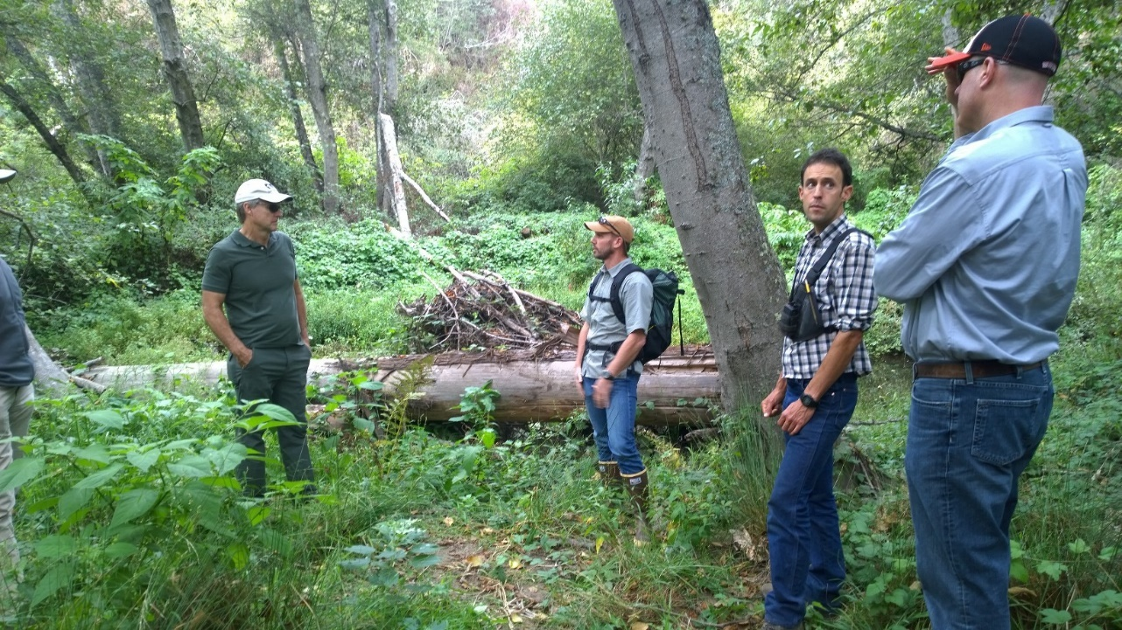
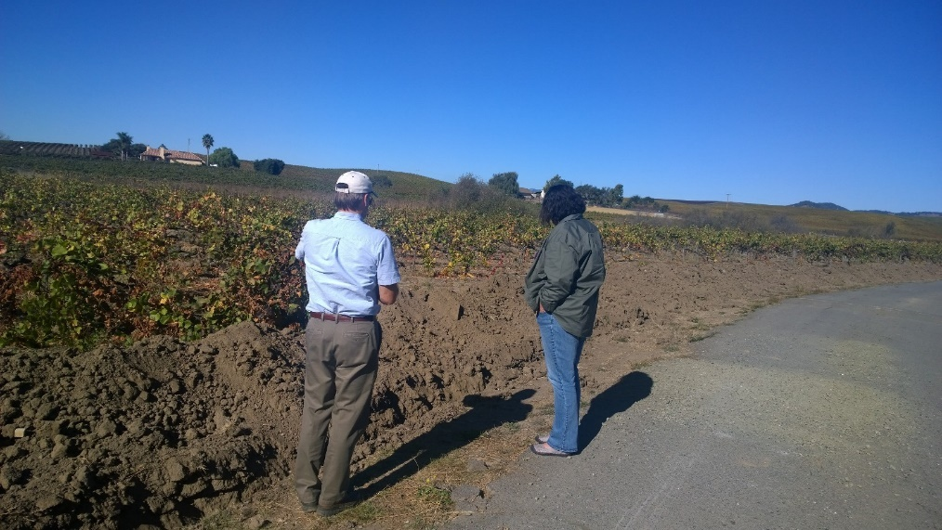
DOC and the RCDs

Slide 3
Funding Purpose
To assist RCDs in building capacity:
Increase best management practices and meet basic legal requirements.
Increase the ability to serve local communities and address local resource issues.
To encourage consistency with CARCD’s 2014 Vision and Standards document.
To encourage RCDs to become more Relevant, Excellent, and Visible (REV).

Slide 4
Grant Requirements
Record keeping
Establish a designated file for all grant-related documents.
File should include documentation of all actions taken under the grant.
Keep all original documents, such as receipts, in your grant file. Submit only copies to DOC.
Competitive bid and prevailing wage
Please be sure to check the competitive bid and prevailing wage requirements for your organization.
Conflict-of-interest clause
Any one paid out of the grant cannot sign invoices or request budget changes. Such requests must come from the grantee’s authorized representative or designee. RCD Boards may name the district manager as the authorized designee.

Slide 5
Invoicing
The required invoice forms were tailored according to your approved grant budget and emailed out to all grantees. - Please do not modify or alter any of the forms or formulas.
- If you require any modifications, please contact your DOC grant administrator who will assist you.
Invoices are due quarterly based on your grant start date or your chosen invoicing/reporting schedule.
- Every 3 months from start date or every 3 months based on a standard fiscal quarter. (January to March, April to June, etc. )

Slide 6
Invoice forms
Each invoice packet will include the following forms:
Quarterly Invoice Summary form (MS Word)
Invoice Detail A (Excel - first tab)
Invoice Detail B (Excel - second tab)
Match Support form(s) (pdf, with drop-down tabs) – submit one form for each match provider. For example, NRCS may provide various match such as tech support and vehicle usage.
Each invoice packet must be accompanied by a progress report.

Slide 7
Reimbursable Expenditures
Must include support documentation, such as time sheets, invoices, receipts, etc. There must be some way to confirm costs made under the grant.
Support documentation must include Cross Reference Numbers (CRNs) which must match the CRN on the invoice forms. The CRN is already listed under the first column on invoice forms A and B.
Write the CRN on the upper right-hand corner of the matching documents. Nothing fancy needed.

Slide 8
Personnel time tracking
Use time sheets to document personnel expenses
Time sheets must be signed by employee and their supervisor (Dept. of Finance requirement).
However, if you are using an electronic time accounting (payroll) system, you may instead provide a payroll spreadsheet that shows the name of each personnel billing for a particular period, the number of hours they worked, the task they worked on, and date they worked. To satisfy the requirement for time sheet signatures, you may provide a letter from your Board that certifies that the payroll is done electronically and that each employee (and their supervisor) electronically verifies the hours and activities on the time sheets.

Slide 9
Invoice Completion
Quarterly Invoice Summary form, fill out:
Submission date and invoicing time period. List period start and end dates.
Grantee name and address.
Grant totals from Invoice Detail B form.
Signature of Authorized Grant Signatory in BLUE Ink.
Feel free to submit draft invoices electronically for review. Please allow a few days for reviews.

Slide 10
Quarterly Invoice Summary Form
DOC RCD Financial Assistance Program
Quarterly Invoice Summary
To: Department of Conservation Date: 9/1/2017
Grant number: 3016-XXX Invoice number: 1
Invoice time period: June 1, 2017 to August 30, 2017
Grantee Name: XX RCD
Grantee Address: 123 Main St, Any town CA 95338
Transfer totals from Invoice Detail B (if no costs, enter a zero).
1. Total Reimbursable costs: $ 5,040.00
2. Cash match: $ 1,022.00
3. In-kind match: $ 978.00
X________________________________________________ X __________________________________________
Signature of Authorized Representative or Designee Print Name and Date
(Please use blue ink)

Slide 11
Invoice Detail A & B Forms
Use these forms to report all grant expenditures.
The forms are tailored to your grant budget.
Detail A (yellow tab)
Include invoice number in sequential format from 1.
Use form to report all personnel costs.
Include all reimbursable, cash, and in-kind match costs.
Include task numbers from your work plan under the task column.

Slide 12
Sample Invoice Detail A
 | Invoice Detail A
 | Grant #: 3016-625 Invoice #: 1
CRN | Budget Category | Reimbursable Costs | Cash Match | In-kind Match | Task #’s (from work plan)
1 | PERSONNEL** (list positions, names and pay rates; list benefits and benefit rate for each person on a separate line.)
1.1a | District Manager (@ $25/hr.) | $1,250 | $625 |  | 1.1, 1.2, 1.4, & 2.1
1.1b | District Manager benefits (@ 32%) | $400 | $200 |  | 1.1, 1.2, 1.4, & 2.1

Slide 13
Invoice Detail B Form
Detail B (green tab)
Include invoice number at top.
Use this form for all non-personnel costs, including consultant costs.
List consultants by name or position title.
Include all reimbursable, cash, and in-kind match costs.
Include the task numbers from your work plan under the task column.

Slide 14
Sample Invoice Detail B
 | Invoice Detail B
 | Grant #: 3016-325 Invoice #: 1
CRN | Budget Category | Reimbursable Costs | Cash Match | In-kind Match | Task #’s (from work plan)
2 | Consultants***(list personnel)
2.1 | Conservation Unlimited - Alexander Woolsey | $2,599 |  |  | 2.1, 2.2, 2.3
 | Subtotal | $2,599
3 | Operating Costs
3.1 | Printing | $500 | $25 |  | 2.3
 | Subtotal | $500 | $25
Write corresponding CRN on upper right corner of supporting documentation (receipts, invoices, etc)

Slide 15
Invoicing Tips
To ensure accuracy, we recommend a secondary review before submitting invoice packets.
Submit via hard copy, in triplicate: 1 original and 2 copies of each invoice and supporting materials.
The original invoice needs to be signed by the grantee’s authorized representative or designee in blue ink (accounting requirement).
Time sheets must be signed by both the employee and a supervisor unless an electronic payroll system is being used. This is a DOF requirement.

Slide 16
Match Support Form
Use one form per match provider.
Form has automatic drop down tabs. Indicate whether match is cash or in-kind by selecting appropriate tab.
Form must be signed by the match provider, if provider is not from the RCD staff. If match is provided by the grantee, the grantee may sign the match form(s).

Slide 17
Sample Match Support Form

Slide 18
Progress Reports
Progress reports are due quarterly.
Submit one electronic copy and one hard copy to your assigned DOC Grant Administrator. The hard copy may be double-sided.
Please use the form provided and do not reformat or alter the form.

Slide 19
Progress Reports
Reports should focus on success stories and the results of your activities rather than simply providing a list of completed tasks.
Use the progress report to promote your RCD’s great work.
We encourage you to submit photos or videos (electronically) to highlight RCD accomplishments.

Slide 20
Budget or Work Plan Changes
Changes are allowable. Contact your DOC Grant Manager to request any changes or modifications to your budget or work plan.
Changes are only valid if made in writing and agreed to by both parties.
Budget or work plan change requests should be signed by a board member or the grantee’s authorized designee.

Slide 21
Additional Tips
Please include your grantee name and grant number with any correspondence with DOC staff. We have 59 RCD grants and other program grants to track.
This will help us to serve you faster.
Never hesitate to ask us questions; we are here to help you successfully complete your grant!

Slide 22
Grant Manager Contact Information
Gail Chun
Email: Gail.Chun@conservation.ca.gov
Phone: 916-323-8930
Jenny Di Stefano
Email: Jenny.E.DiStefano@conservation.ca.gov
Phone: 916-804-2345

Slide 23
Questions?

